Slide 1
Memory-Powered Marketing Agents

Slide 2
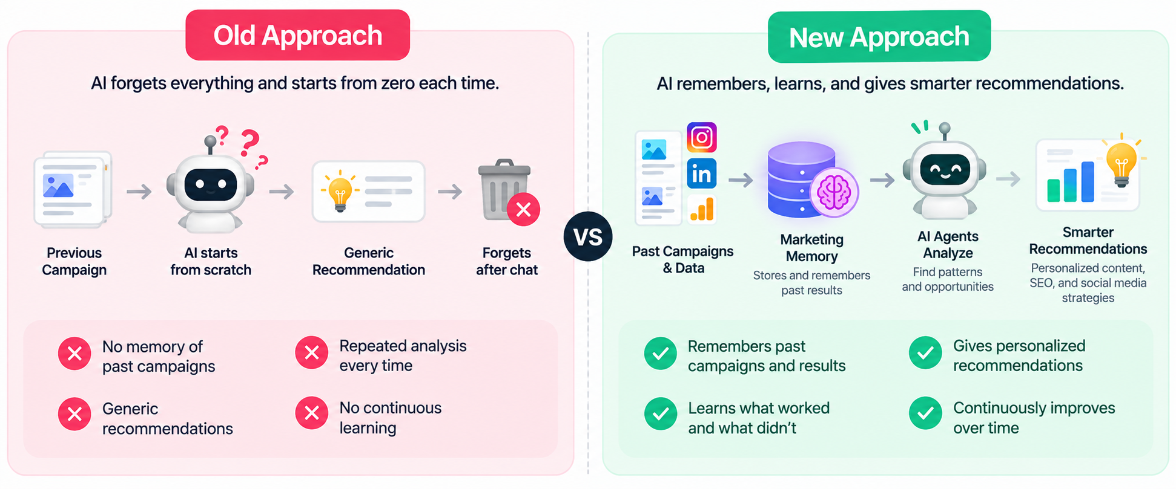
The Problem:

Slide 3
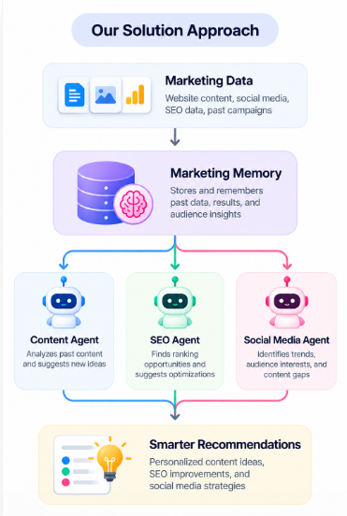
Approach for the Solution:
Three Agents- On Shared Marketing Memory.
1.Content Strategy Agent:
Tracks what content was published and how it performed.
Learns the brand’s voice, audience preferences, and successful topics.
Identifies content gaps and recommends what to create next.
2. SEO & Citation Agent:
Tracks search rankings, keywords, and past SEO changes.
Remembers what optimizations improved or hurt performance.
Suggests new SEO opportunities and citation strategies based on historical data.
3. Social Media Engagement Agent
Tracks posts, engagement, audience reactions, and posting times.
Learns which topics and post styles work best for the audience.
Recommends future posts and engagement strategies based on past performance.

Slide 4
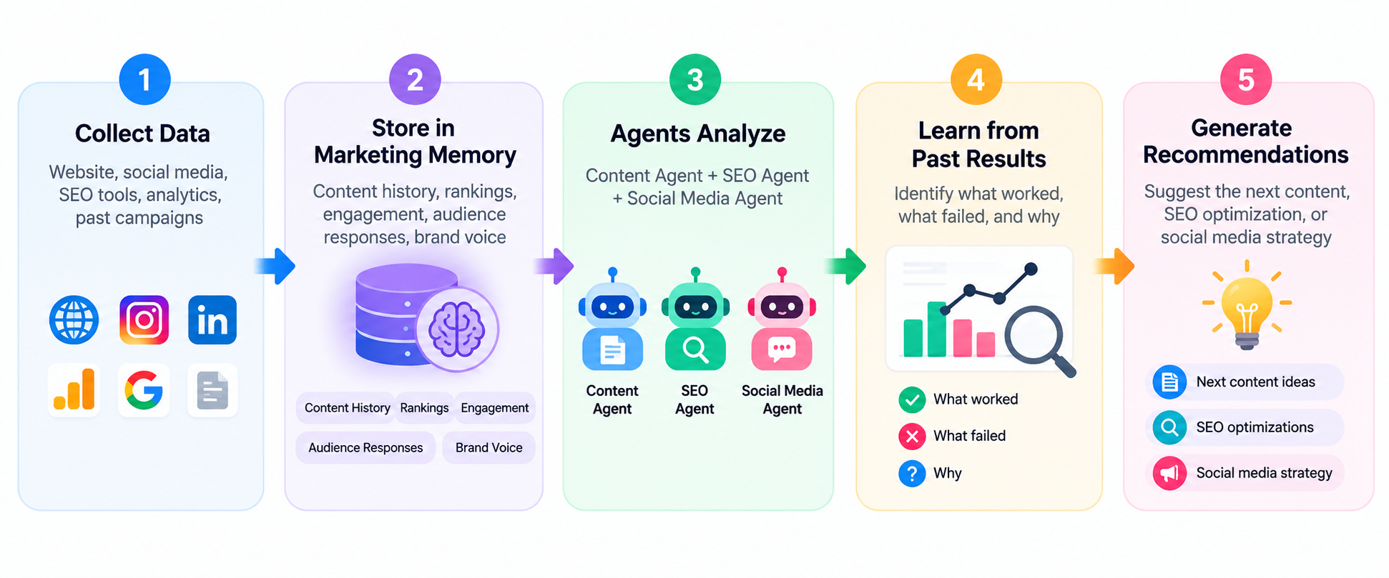
Flowchart of the approach:

Slide 5
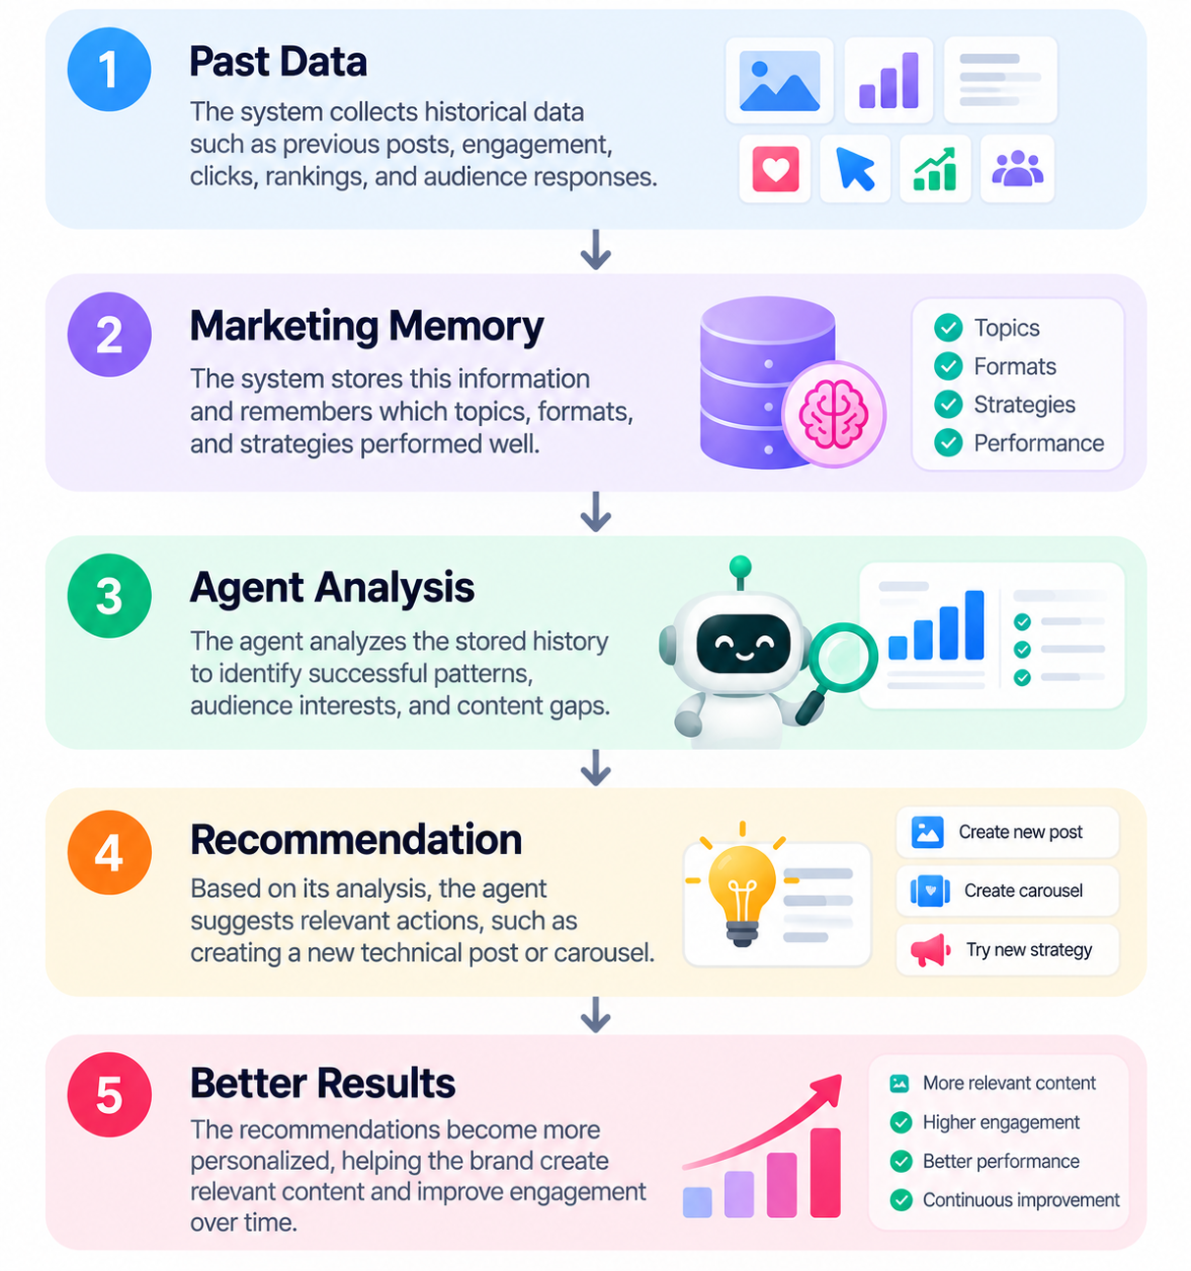
How Our Agents Make Smarter Decisions:
Past Data
Previous posts
Engagement & clicks
Marketing Memory
Stores historical data
Remembers successful topics
Agent Analysis
Finds successful patterns
Understands audience interests
Recommendation
Suggests relevant content
Recommends new strategies
Better Results
More personalized decisions
More relevant content

Slide 6
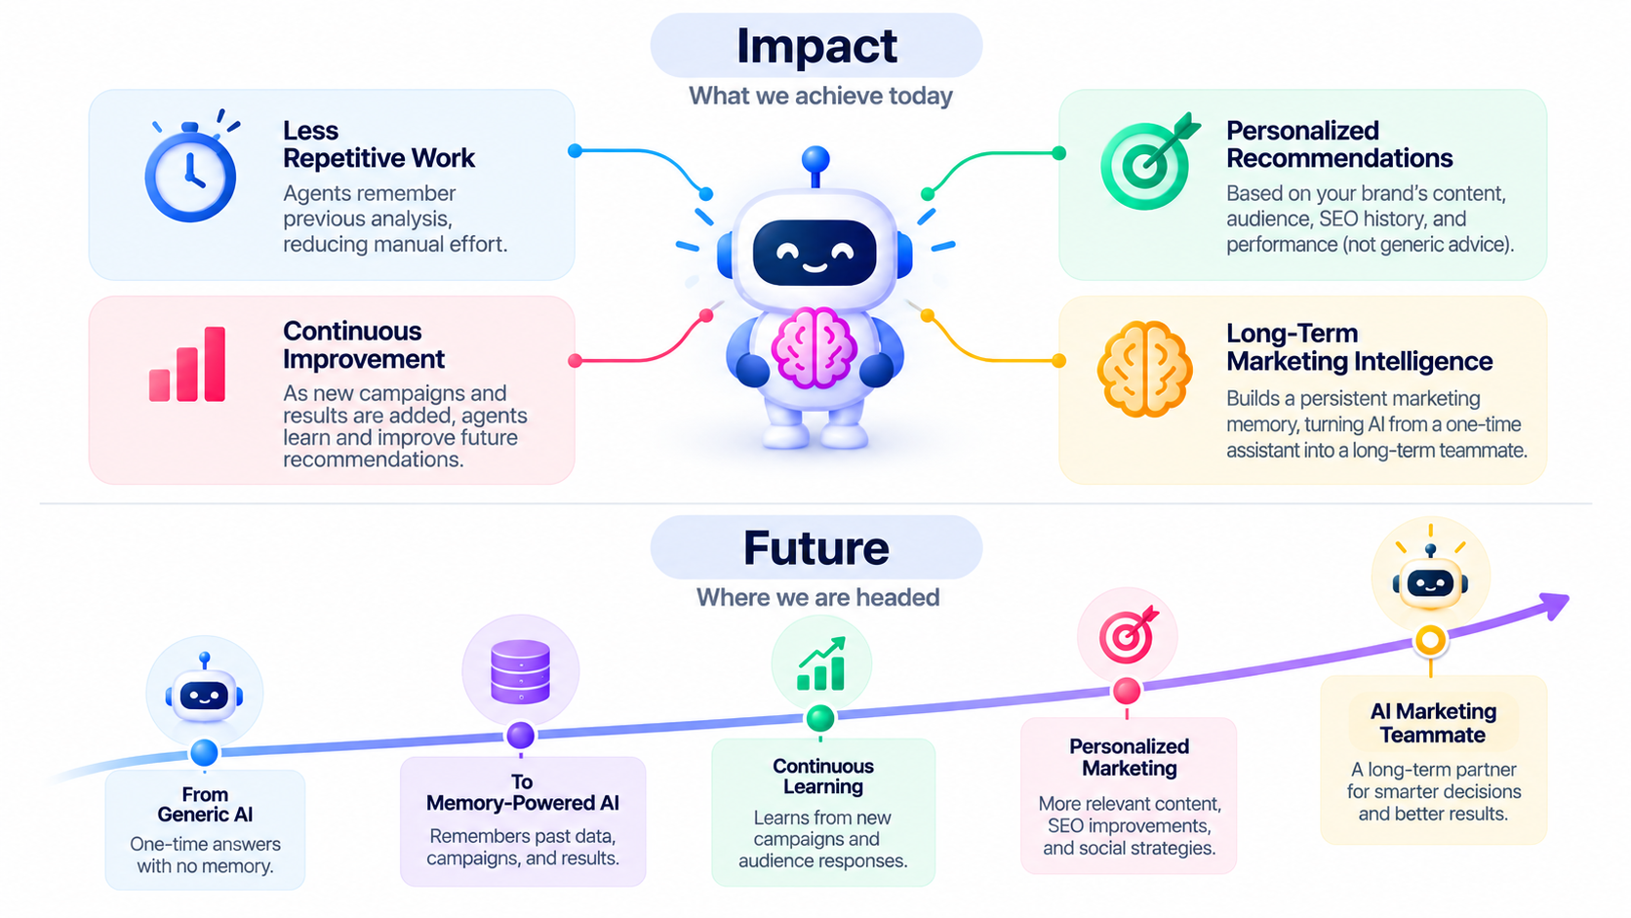
Impact and Future:

